Slide 1
It’s getting hot in here
Lauren Hettiaratchi ST8 Paediatrics

Slide 2

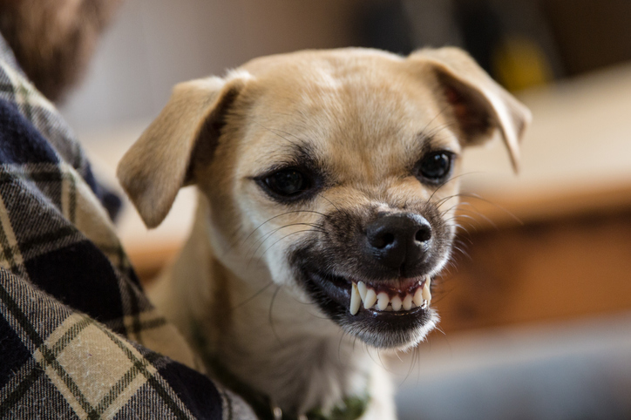
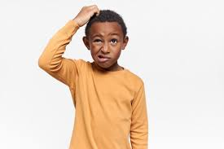

11yo girl arrives in ED
Notes:
11yo girl presents to ED one weekend in June. On arrival walked in but aggressive- hitting the nursing staff, screaming, appearing confused and refusing to open her eyes

Slide 3


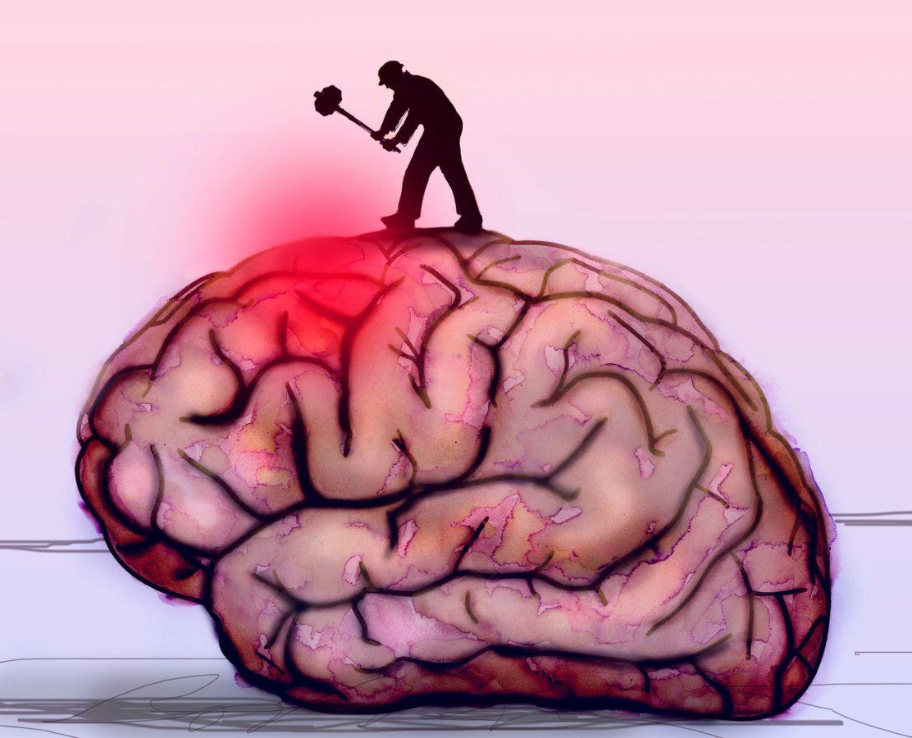



Earlier that morning…
Notes:
Went to park run, afterwards c/o headache, vomited 3 times and became very drowsy. BG fit and well apart from Lyme disease. No hx of trauma, ingestion or fever. Dad said did feel hot and sweaty at home and he gave calpol

Slide 4



Background
2021
Temperature dysregulation
Fever headache confusion
IV ceftriaxone
Mood dysregulation

Slide 5



Examination
A
B
Sao2 99% in air, nil resp distress, chest clear
C
Cold peripheries, CCR 3s
HR 110, BP….
Patent, groaning

Slide 6




101/63
86/41
80/35
Notes:
On examination- hypotensive, required 30ml/kg fluid boluses to maintain

Slide 7

D
Fluctuating GCS
E
Temp 36.3
Last PU 6 hours ago
Nil rashes/injuries
F
Notes:
Agitated, refusing to open eyes, groaning in response to pain, lashing out with limbs

Slide 8

pH 7.52
pCO2 3.6
BE -0.7
HCO3 23.8
Glucose 3.6
Lactate 7
Notes:
?meningoencephalitis ?ingestion ?ADEM ?seizure disorder severe dehydration

Slide 9
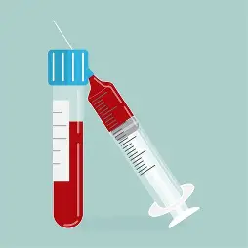

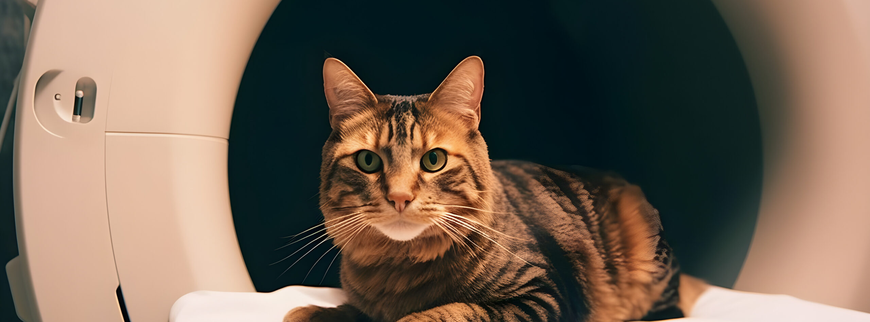

Slide 10
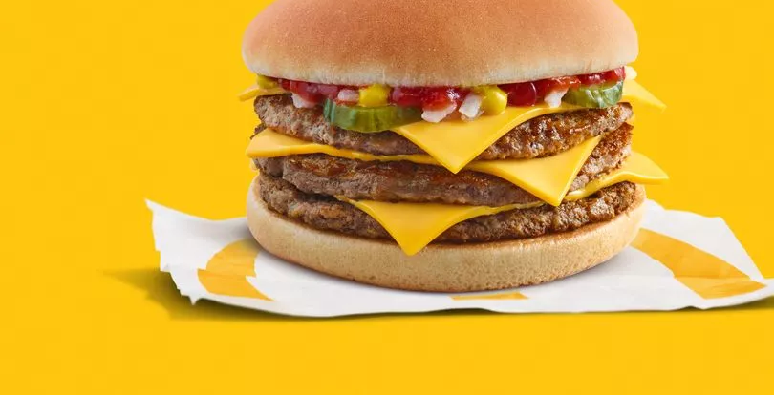
Antibiotics
Fluids
Neuro obs
Admit

Slide 11


What about me?!

Slide 12




Slide 13



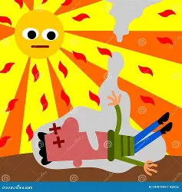


Slide 14
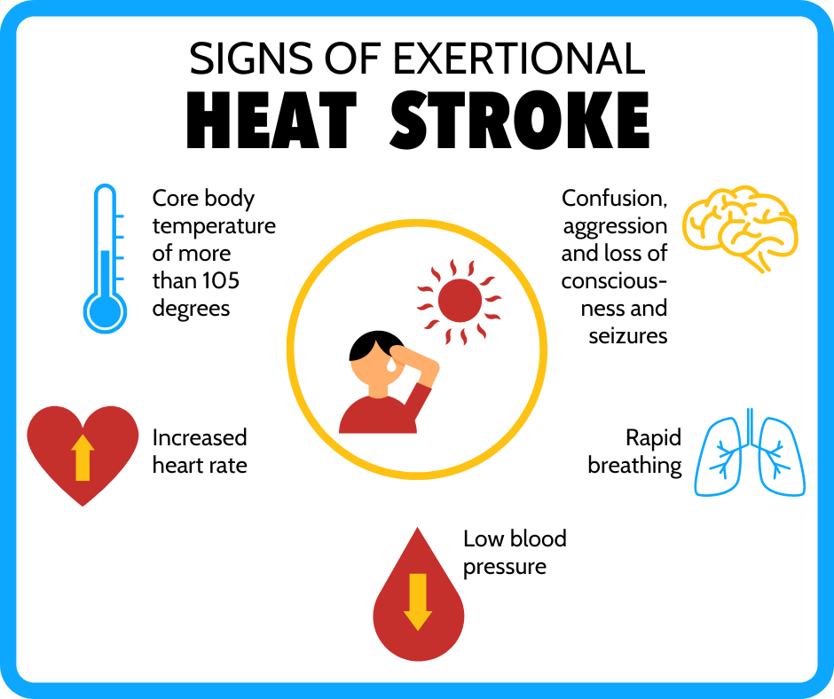

Slide 15

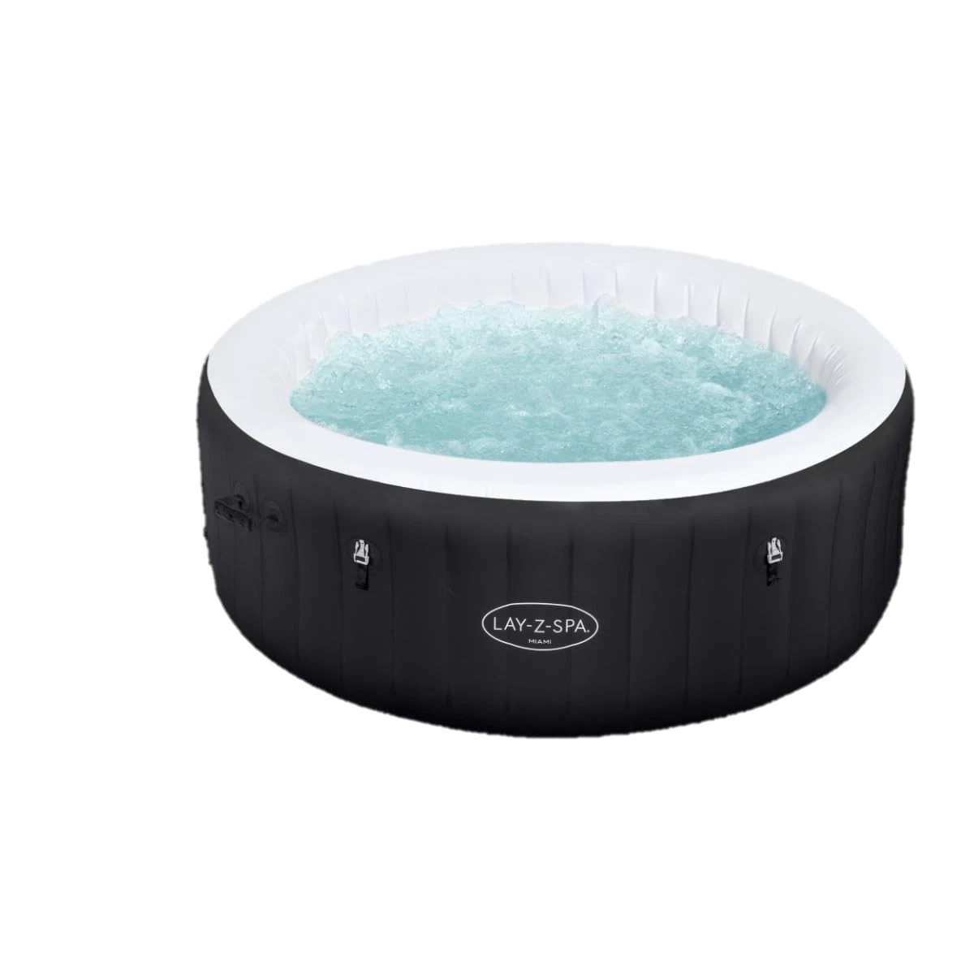
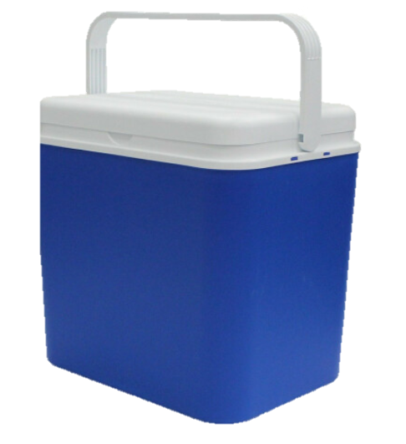
Greater SA to body mass
Higher metabolic rate
Reduced sweating

Slide 16
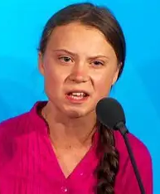
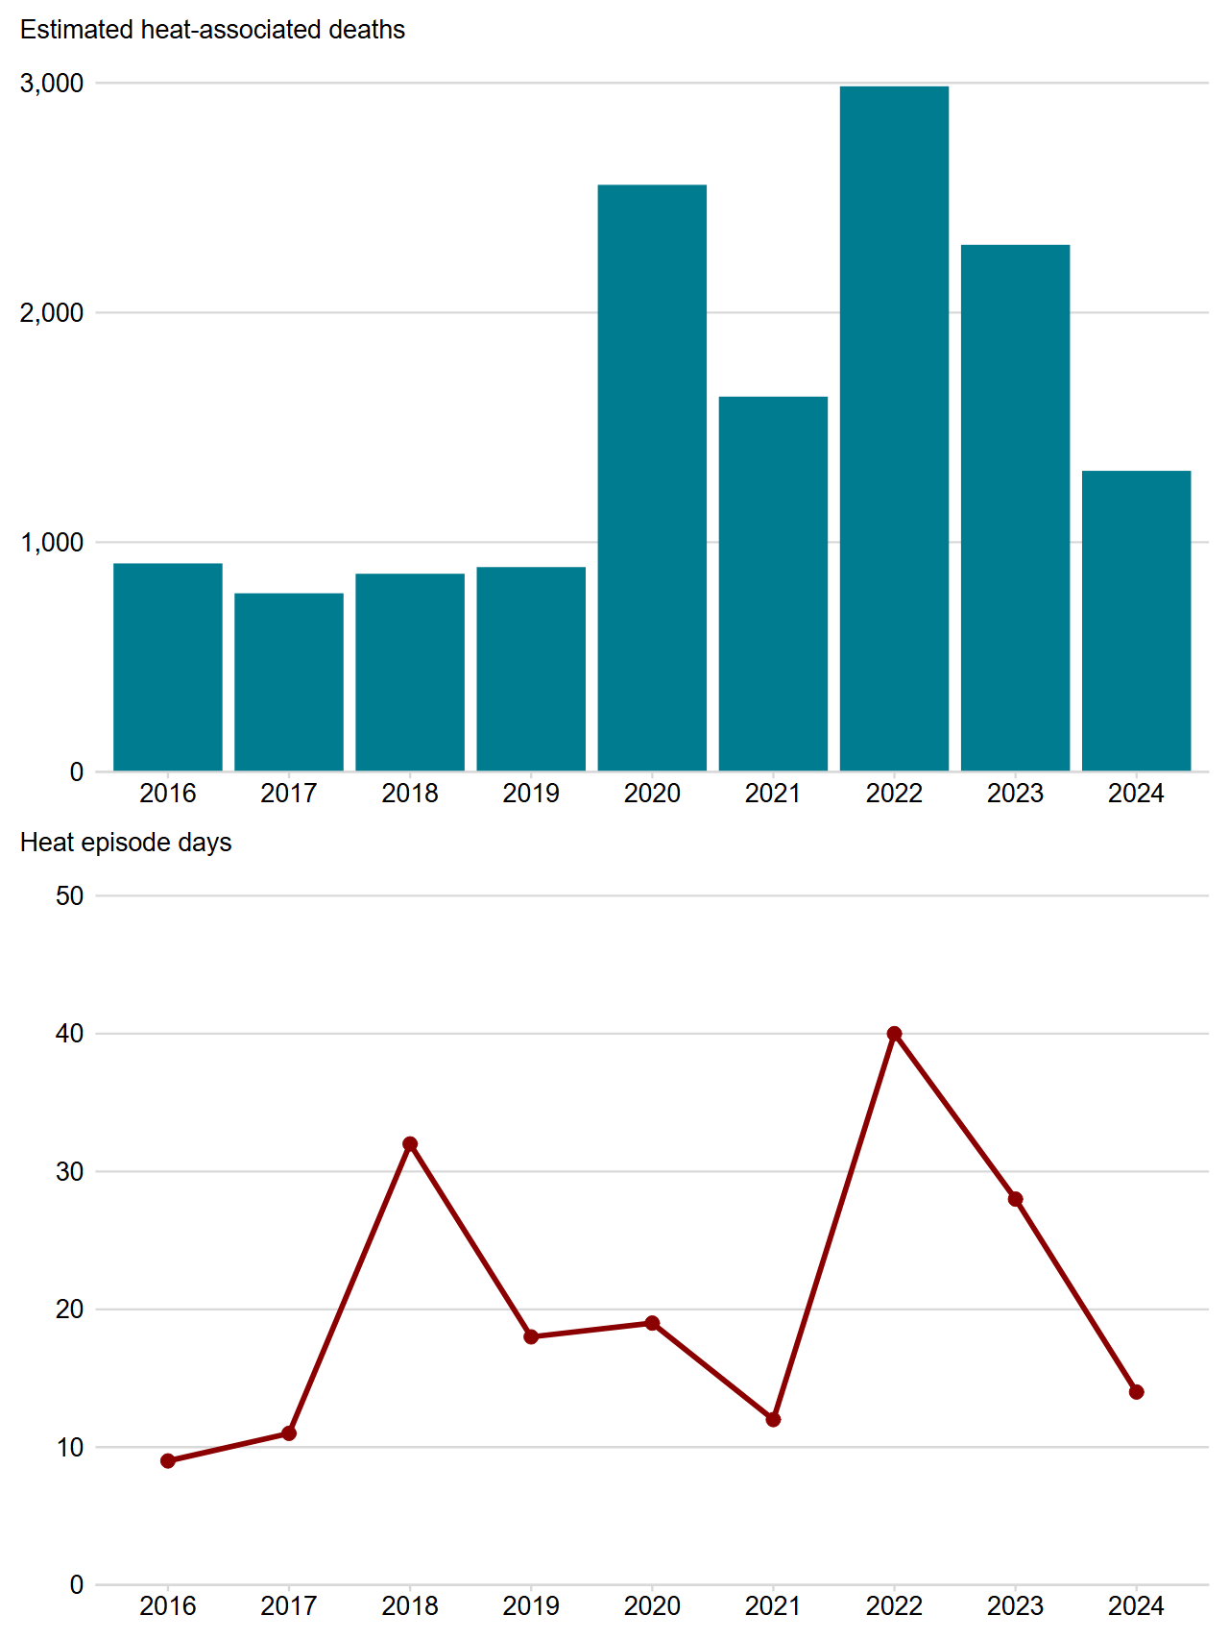


Slide 17


