Slide 1
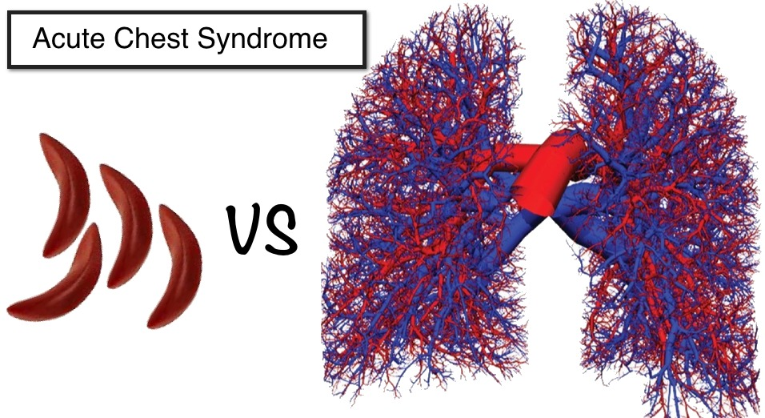
The Chest in Crisis: Lessons from a Sickle Cell Storm
By
Alaa Hassan
Paediatric ST8
Croydon University Hospital

Slide 2
Presenting complaint
16 years old female
Chest pain and back pain in a child known to have HbSS
Intermittent SOB
No fever
No coryzal symptoms

Slide 3
Some background on the child
Sickle Cell Disease HbSS
Acute chest syndrome with Flu-B
Cholecystectomy
Recent ECHO: NAD
On Hydroxycarbamide 1500mg/day (taking it occasionally)
Not compliant with her regular medications
Missed her transition clinic on the year of this presentation

Slide 4
Timeline: from presentation till retrieval
Presented with back pain resolved with oral morphine and sent home
Re-presented after 24hrs with chest pain, back pain and fever
Despite admission and starting treatment, very rapid respiratory deterioration over 24 hours till intubated and retrieved to PICU

Slide 5
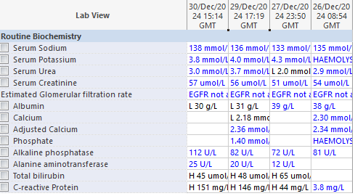
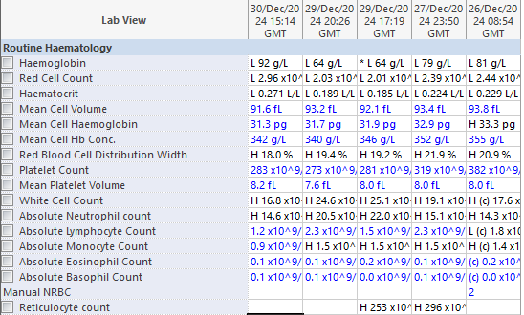
Blood results

Slide 6
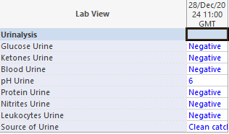
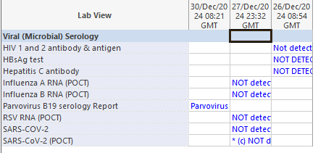

Slide 7
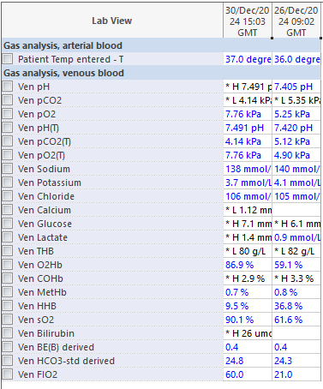
Blood gases

Slide 8
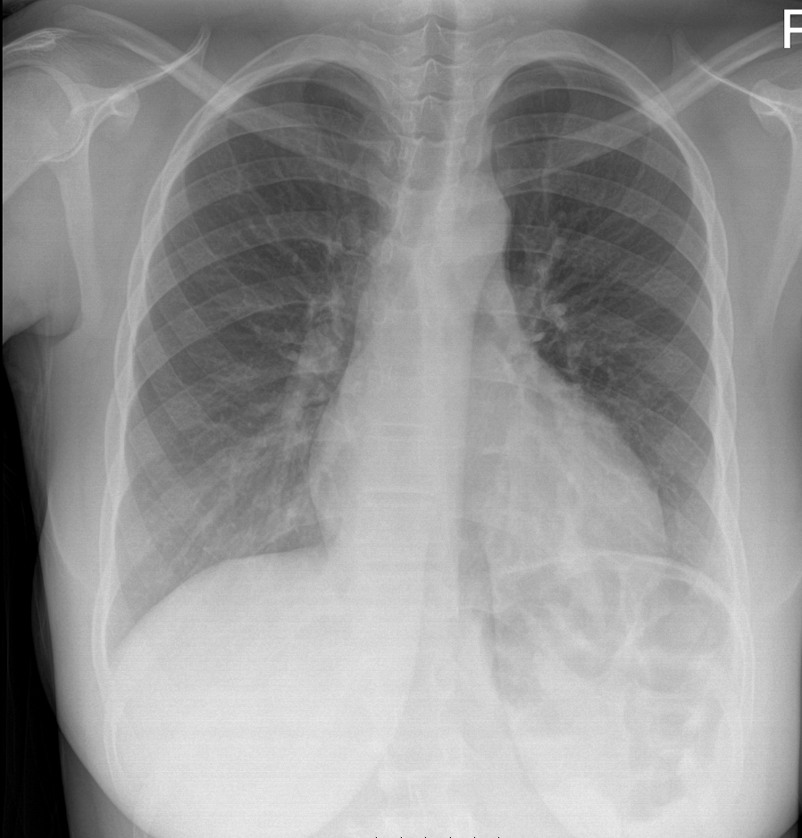
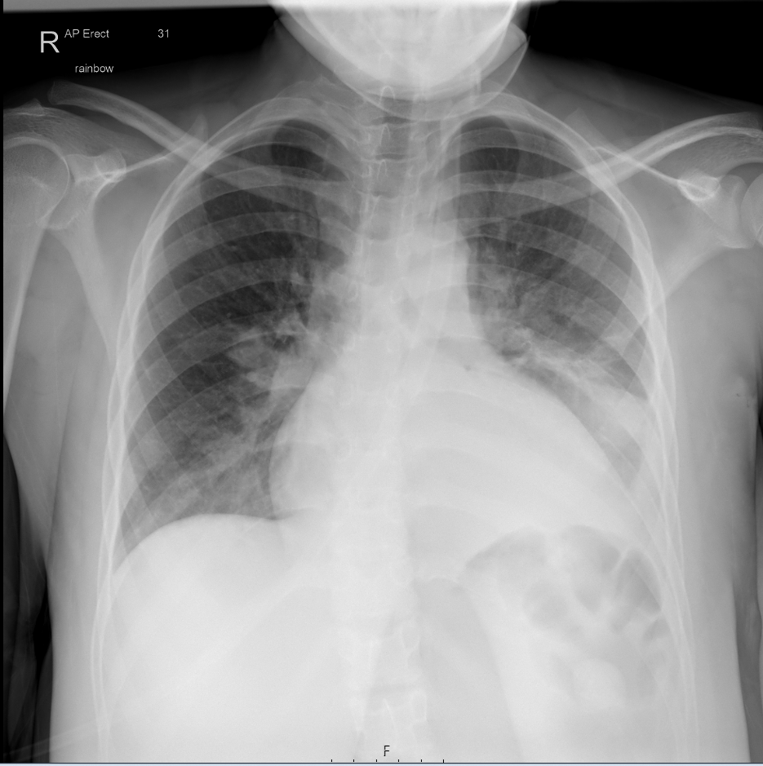
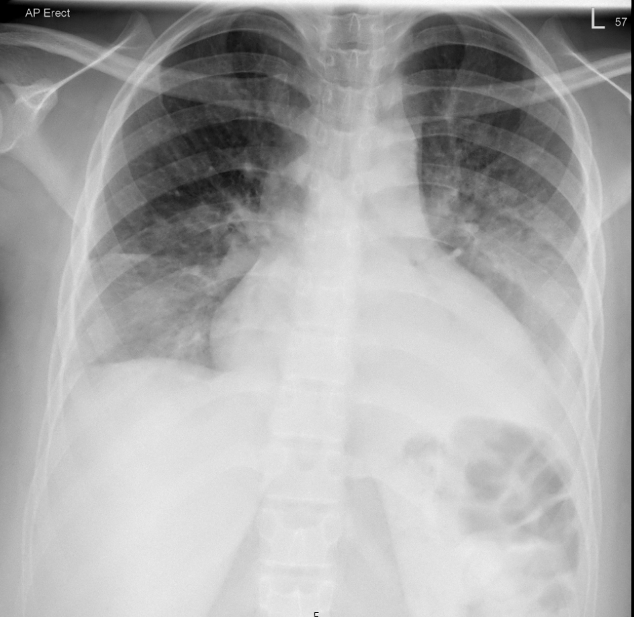



CXR

Slide 9
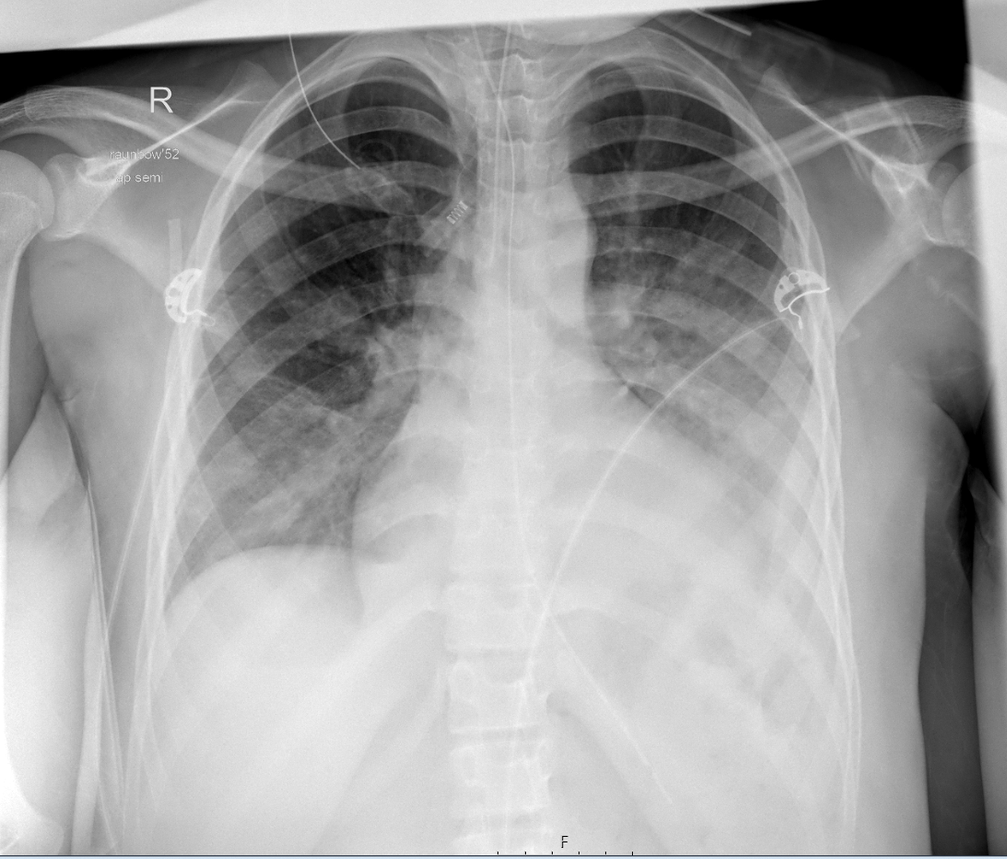

Post-intubation CXR

Slide 10
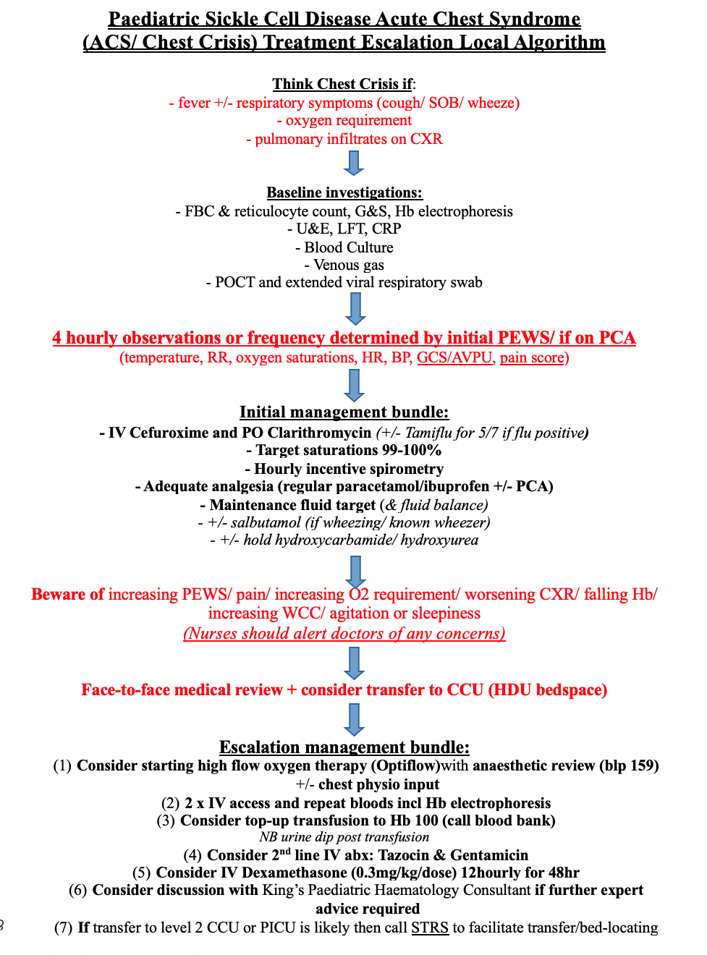

Slide 11
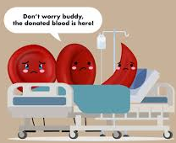
Why Focus on Sickle Cell?
~250 children under 18 years old in Croydon live with sickle cell disease.
180 children are under active follow-up at Croydon University Hospital.
The majority have HbSS or HbSC genotypes — with HbSS being more common.

Slide 12
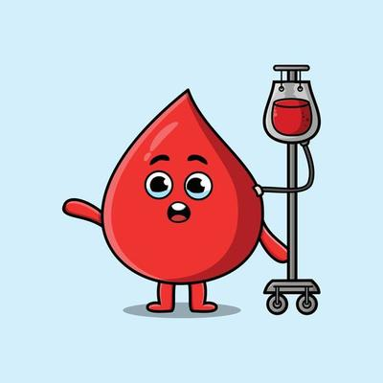
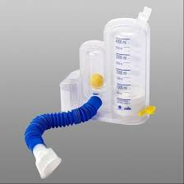
Lessons Learned
Children experiencing a sickle cell crisis can deteriorate rapidly.
Be prepared to escalate care promptly when indicated.
Implement general protective measures: hourly incentive spirometry, top-up transfusion( aim Hb >100), and maintain oxygen saturation at 99–100%.
Liaise early with the paediatric haematology consultant and consider transfer to Level 2 CCU or PICU if required.

